Slide 1
Complex Systems Science: Dreams Of Universality, Reality Of Interdisciplinarity
S. Grauwin , G. Beslon , E. Fleury , S. Franceschelli , C. Robardet , J. Rouquier , P. Jensen .
arXiv : 1206.2216v1
11 Jun 2012

Slide 2
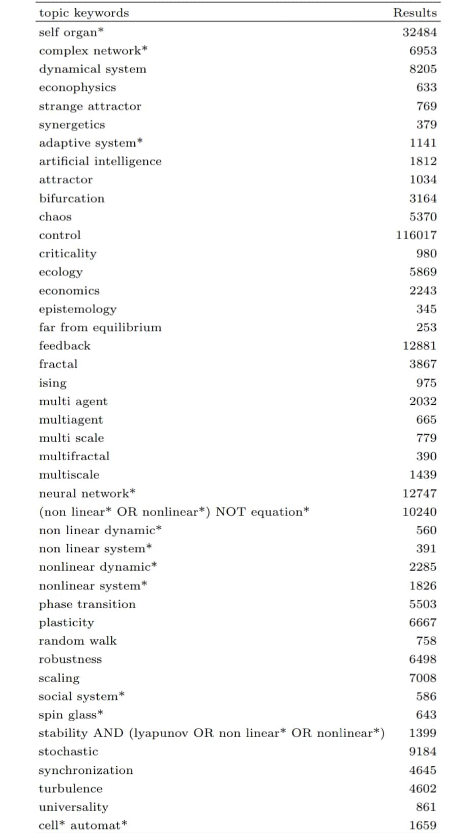

Slide 3
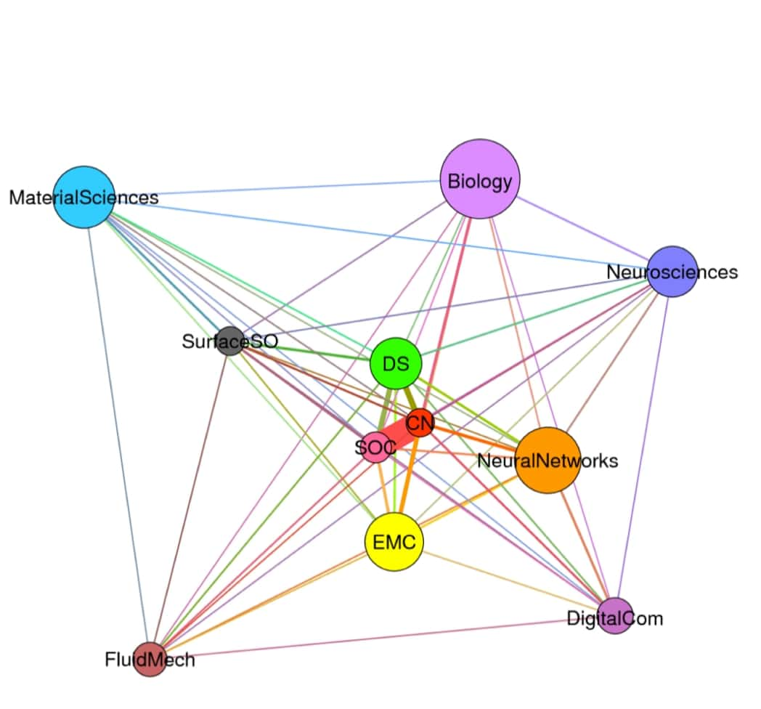

Slide 4
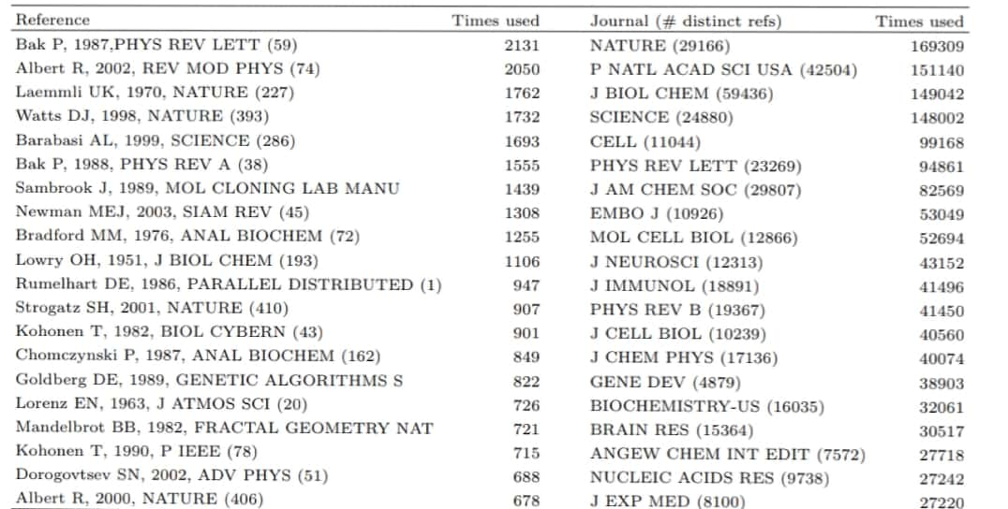

Slide 5
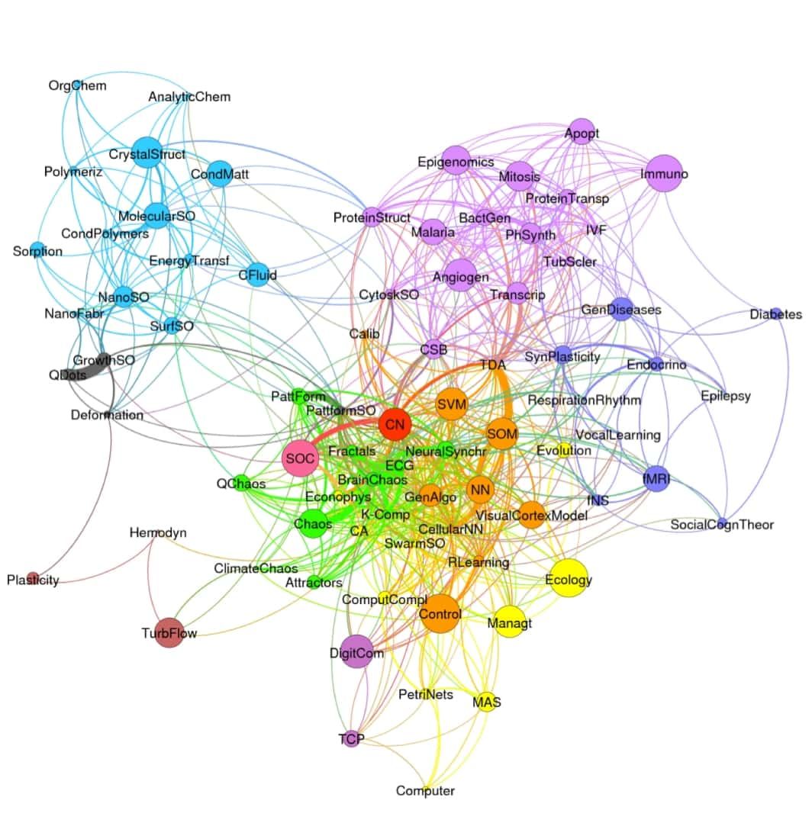

Slide 6
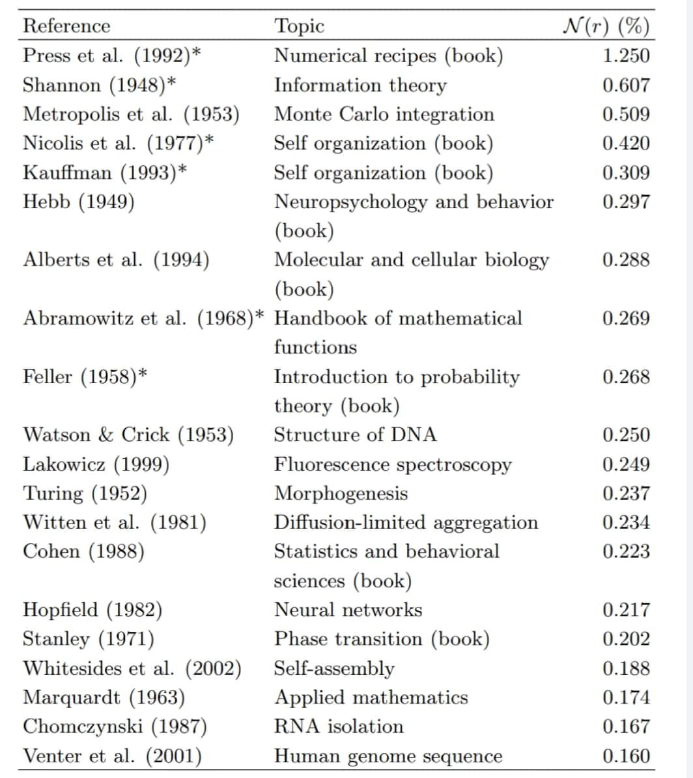

Slide 7
Thanks for paying attention

